Slide 1
Prepositions in Ancient Greek
Prof. Vanessa Gorman
University of Nebraska-Lincoln
vgorman1@unl.edu

Slide 2
Prepositions
A preposition is a word that sets up a relationship between a noun/pronoun and some other word in the sentence. [on, in, from, during, for, etc.]
Used to express a spatial or temporal relation or mark a semantic role.
A prepositional phrase includes, minimally, a short, indeclinable word, called a “preposition,” and a substantive in an oblique case [NOT nominative] used as its “object.”
“on the pool table”
“in Delos”
“from genuine gratitude”
“during the long and bloody war”
“for them”

Slide 3
Prepositions were originally adverbs
“Pericles marched out.” [adverb]
“Pericles marched out the gate.” [prepositional phrase]
“Pericles marched out the southernmost gate which was facing toward the sea.” [Prepositional phrase can be quite lengthy!]

Slide 4
Prepositions in Dependency Grammar
The Part of Speech is always adposition [ADP] in the trees
In Greek, the preposition sometimes occurs after its object.
The “relation” of the preposition word itself is always the same: AuxP.
The object of the preposition can function [relation] substantively, adverbially, or adjectivally.
“They marched into Caria.” [OBJ]
“They marched into Caria with great speed .” [ADV]
“The army in Ionia marched into Caria with great speed.” [adjectival = ATR]

Slide 5
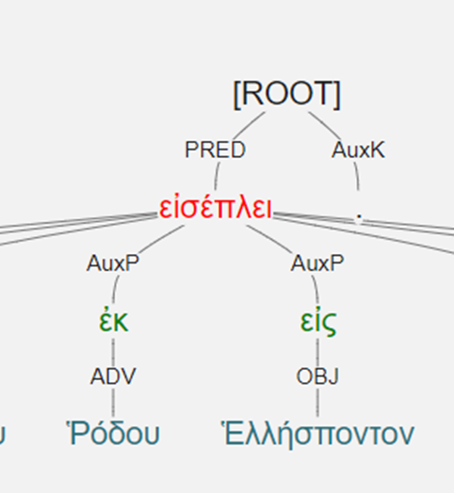
ἐκ Ῥόδου = “out of Rhodes”
εἰς Ἑλλήσποντον = “into the Hellespont”

Slide 6
Top Five Prepositions in Xenophon’s Hellenica
εἰς = into [+ acc]
ἐν = in [+ dat]
ἐπί = on, against, for [+ gen, dat, acc]
ἐκ = out of [+ gen]
πρός = to [+ acc]

Slide 7
Cases
Genitive = place from which, separation, time until
Motion/time away from = ἀπό and ἐκ [out of or from]
Separation = ἔξω [outside of]
Time until/before = μέχρι [until], πρό [before]
Miscellaneous = ἀντί [in exchange for], ἕνεκα [on account of; usually postpositive], πλήν [except]
Dative = where, when, with, by means of
ἐν [in or at], σύν [with]
Accusative = place to which
εἰς/ἐς [into]

Slide 8
Some take multiple cases with the same general meaning
κατά = “down from” [+ gen or acc]
ὑπέρ = “over” [+ gen or acc]
περί = “around,” “about,” “concerning” [+ gen, dat, or acc]

Slide 9
Some take multiple cases with different meanings
πρός
gen = from
dat = near or in addition to
acc = to or toward
ὑπό = “under” or “by”
gen = position or agent
dat = under the power of
acc = during

Slide 10
Some take multiple cases with different meanings
μετά
genitive case = with
Μίνδαρος ἦσαν καὶ Φαρνάβαζος μετὰ τοῦ πεζοῦ.
Mindaros and Pharnabazos were with the infantry.
accusative case = after
μετὰ τὴν ἐκκλησίαν ἀνηγάγετο.
He set off after the assembly
διά
gen = through
acc = by reason of

Slide 11
Some take multiple cases with different meanings
ἐπί
gen = in the time of
dat = in addition to
acc = toward or against
παρά
gen = from
dat = alongside or at the house of
acc = to the side of or beyond

Slide 12
 | form | translation | case | count
1 | ἀντὶ | against, in exchange for | gen | 31
2 | ἀπὸ, ἀφʼ | From, by | gen | 176
3 | διὰ | through | gen, acc | 165
4 | εἰς, ἐς | into | acc | 764
5 | ἐκ, ἐξ | out of | gen | 432
6 | ἐν | in | dat | 686
7 | ἕνεκα | on account of | gen | 25
8 | ἔξω | outside of | gen | 36
9 | ἐπὶ, ἐπʼ, ἐφʼ | on, against, for | gen, dat, acc | 521
10 | κατὰ, καθʼ | down | gen, acc | 254
11 | μετὰ, μετʼ, μεθʼ | with (gen), after (acc) | gen, dat, acc | 202
12 | μέχρι | until | gen | 37
13 | παρὰ, παρʼ | beside, from, near | gen, dat, acc | 147
14 | περὶ | around, about | gen, dat, acc | 254
15 | πλὴν | except | gen | 28
16 | πρὸ | before | gen | 28
17 | πρὸς | to | acc | 399
18 | σὺν | with | dat | 129
19 | ὑπὲρ | over, beyond, concerning | gen, acc | 35
20 | ὑπὸ, ὑπʼ, ὑφ' | by (agent), under | gen, dat, acc | 202

Slide 13
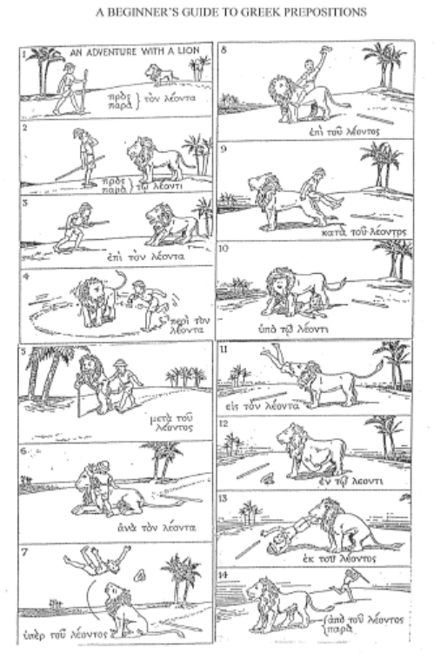
A Beginners’ Guide
to Prepositions
ὁ λέων = nom
τοῦ λέοντος = gen
τῷ λέοντι = dat
τὸν λέοντον = acc

Slide 14
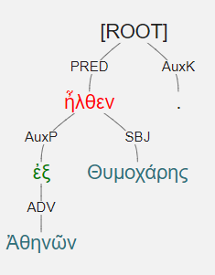
ἦλθεν ἐξ Ἀθηνῶν Θυμοχάρης. [1.1.1]

Slide 15
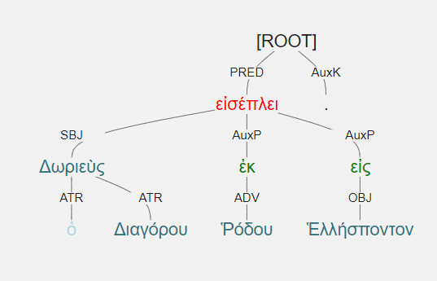
Δωριεὺς ὁ Διαγόρου ἐκ Ῥόδου εἰς Ἑλλήσποντον εἰσέπλει. [1.1.2]

Slide 16
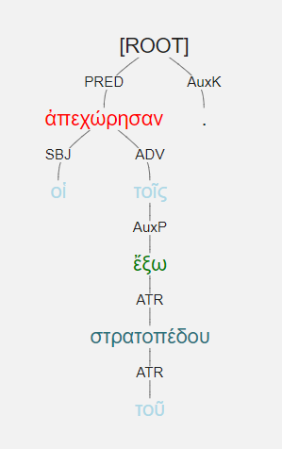
οἱ ἀπεχώρησαν τοῖς ἔξω τοῦ στρατοπέδου.

Slide 17
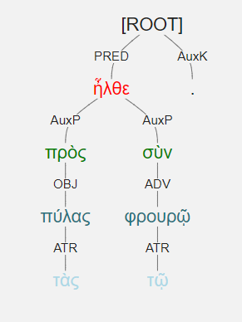
ἦλθε πρὸς τὰς πύλας σὺν τῷ φρουρῷ.

Slide 18
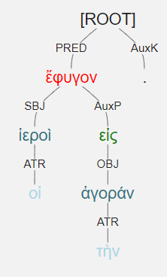
οἱ ἱεροὶ ἔφυγον εἰς τὴν ἀγοράν.

Slide 19
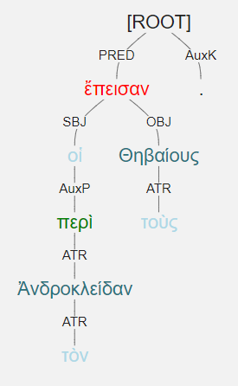
οἱ περὶ τὸν Ἀνδροκλείδαν ἔπεισαν τοὺς Θηβαίους. [3.5.4]

Slide 20
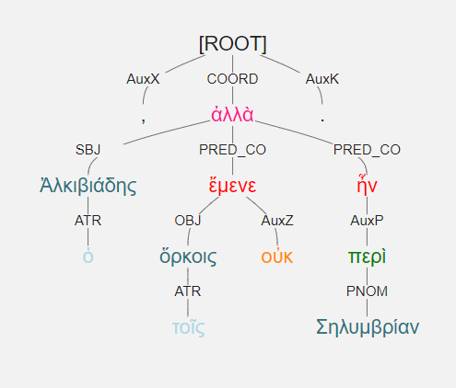
ὁ Ἀλκιβιάδης τοῖς ὅρκοις οὐκ ἔμενε, ἀλλὰ περὶ Σηλυμβρίαν ἦν.

Slide 21
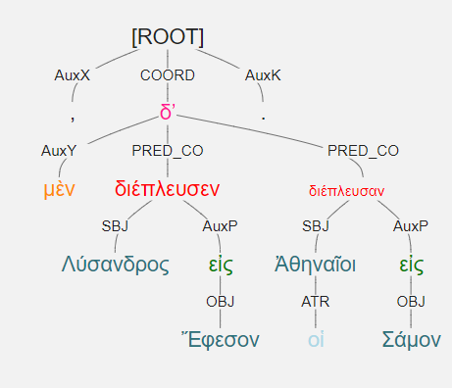
Λύσανδρος μὲν διέπλευσεν εἰς Ἔφεσον, οἱ δʼ Ἀθηναῖοι [διέπλευσαν] εἰς Σάμον. Verb is elided.

